Slide 1


Slide 2
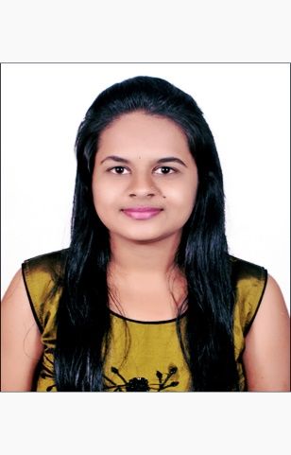
Project Highlights
Project Name : Top Women Chess Players Analysis
Team Size : 1
BU Mentor Name : Samyukta Mentor PS: 20033200
Hemalatha R
99002622
2009BLRMED01
B.E Computer Science and Engineering

Slide 3
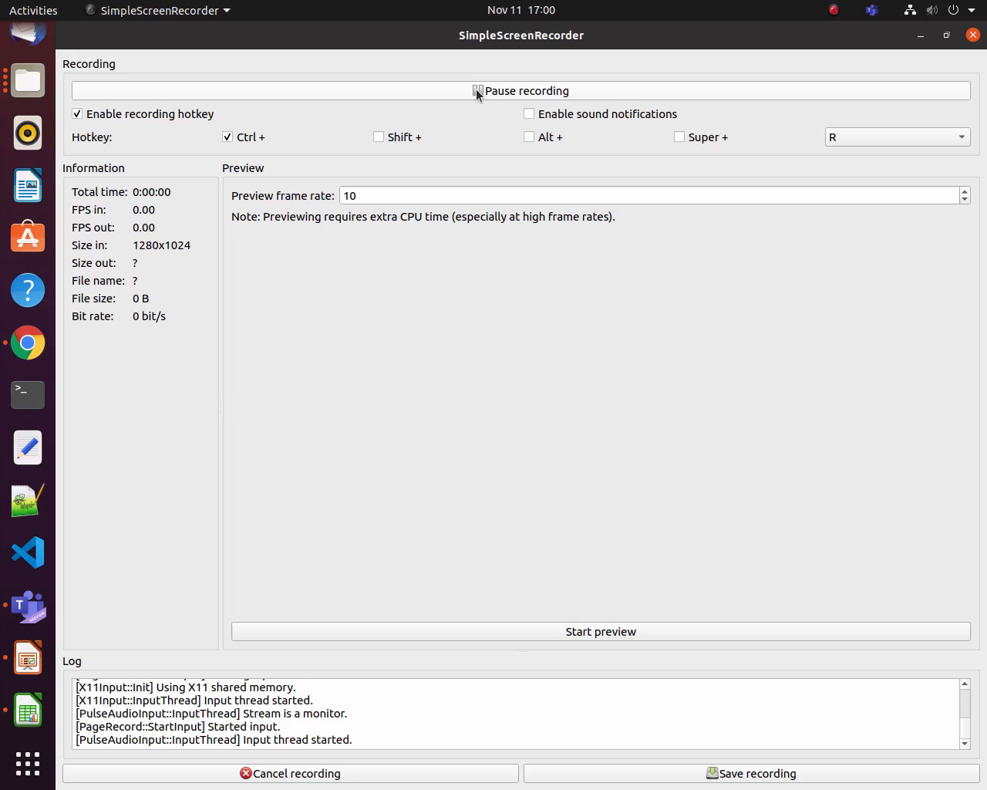
Project Video Snippet

Slide 4
Further Enhancements
This project can be implemented further by adding some other features like displaying the players personal details if we give their Name or ID.

Slide 5


Thank You !

